Slide 1
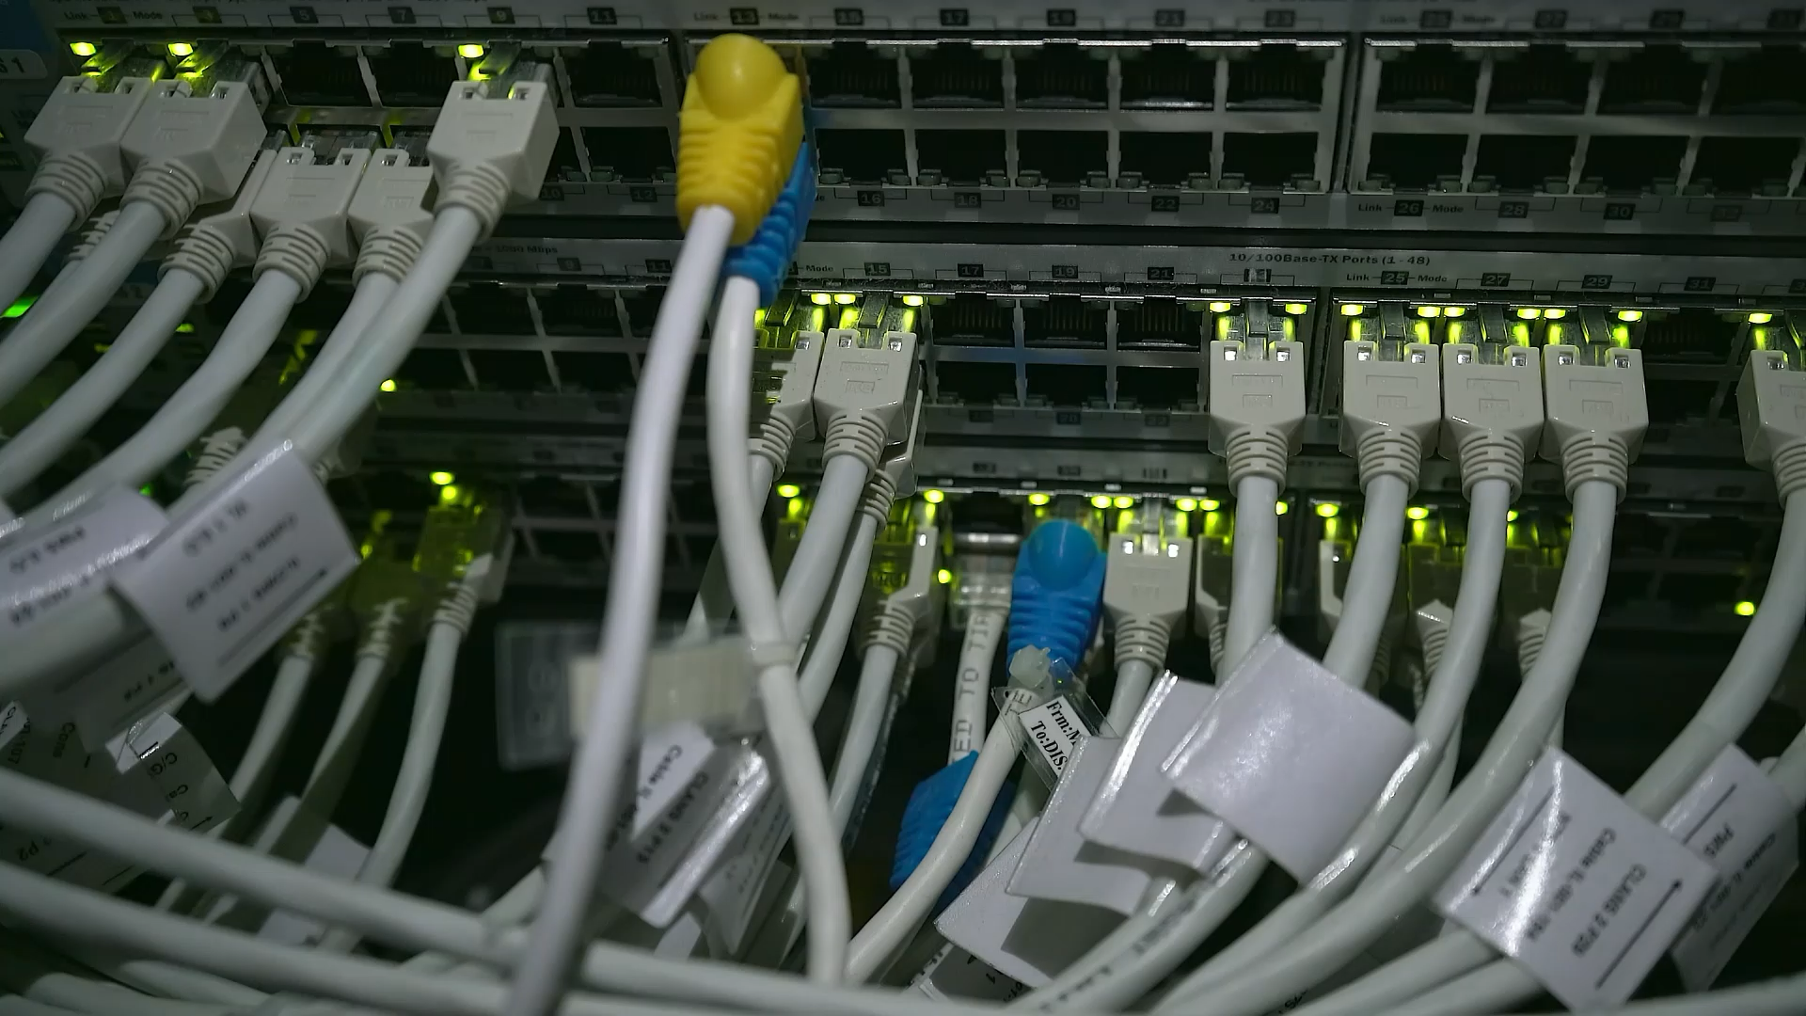
Input and Output

Slide 2
What We’ll Be Talking About Today
IO Streams
Scanner
Live Share Time
Lab

Slide 3
I/O Streams
An I/O Stream represents an input source or an output destination.
A stream can represent many different kinds of sources and destinations, including disk files, devices, other programs, and memory arrays.
Streams support many different kinds of data, including simple bytes, primitive data types, localized characters, and objects.
Some streams simply pass on data; others manipulate and transform the data in useful ways.

Slide 4
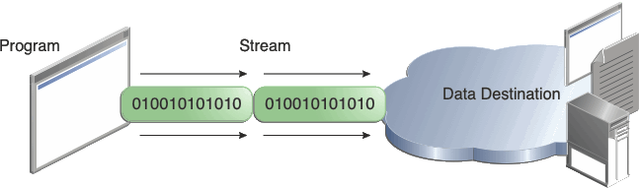
I/O Streams
No matter how they work internally, all streams present the same simple model to programs that use them: A stream is a sequence of data.
A program uses an input stream to read data from a source, one item at a time:
Program
Stream

Slide 5
I/O Streams
A program uses an output stream to write data to a destination, one item at time:
Program
Stream

Slide 6
Byte Streams
Programs use byte streams to perform input and output of 8-bit bytes. All byte stream classes are descended from InputStream and OutputStream.
There are many byte stream classes. To demonstrate how byte streams work, we'll focus on the file I/O byte streams, FileInputStream and FileOutputStream.
Other kinds of byte streams are used in much the same way; they differ mainly in the way they are constructed.

Slide 7
Using Byte Streams
We'll explore FileInputStream and FileOutputStream by examining an example program named CopyBytes, which uses byte streams to copy xanadu.txt, one byte at a time.

Slide 8
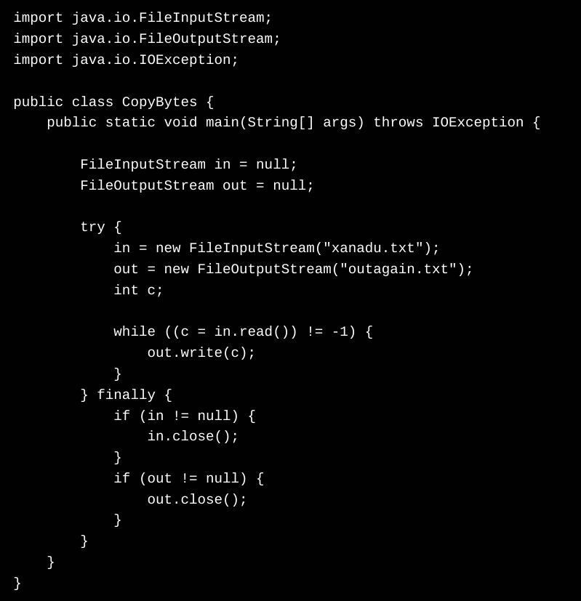

Slide 9
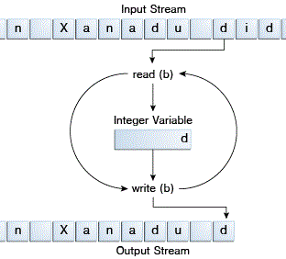
Using Byte Streams
CopyBytes spends most of its time in a simple loop that reads the input stream and writes the output stream, one byte at a time, as shown in the following figure.

Slide 10

Always Close Streams
Closing a stream when it's no longer needed is very important — so important that CopyBytes uses a finally block to guarantee that both streams will be closed even if an error occurs. This practice helps avoid serious resource leaks.
One possible error is that CopyBytes was unable to open one or both files. When that happens, the stream variable corresponding to the file never changes from its initial null value. That's why CopyBytes makes sure that each stream variable contains an object reference before invoking close.

Slide 11
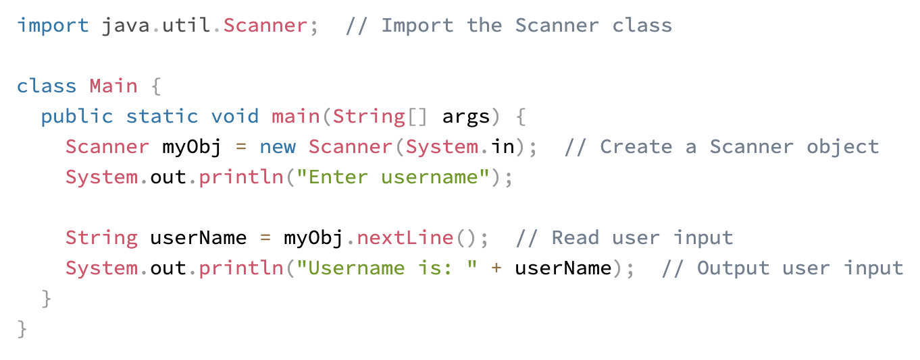
Scanner Class
The Scanner class is used to get user input, and it is found in the java.util package.

Slide 12
Scanner Class
In order to use the Scanner Class you must first create an object of it.

Slide 13
Scanner Class
Once you have your object you can call methods from it and return data.

Slide 14
Scanner Class
All together we have a scanner which can be used to deliver user input.

Slide 15
Scanner Class
The scanner class has many methods:
Method | Description
nextBoolean() | Reads a boolean value from the user
nextByte() | Reads a byte value from the user
nextDouble() | Reads a double value from the user
nextFloat() | Reads a float value from the user
nextInt() | Reads a int value from the user
nextLine() | Reads a String value from the user
nextLong() | Reads a long value from the user
nextShort() | Reads a short value from the user

Slide 16
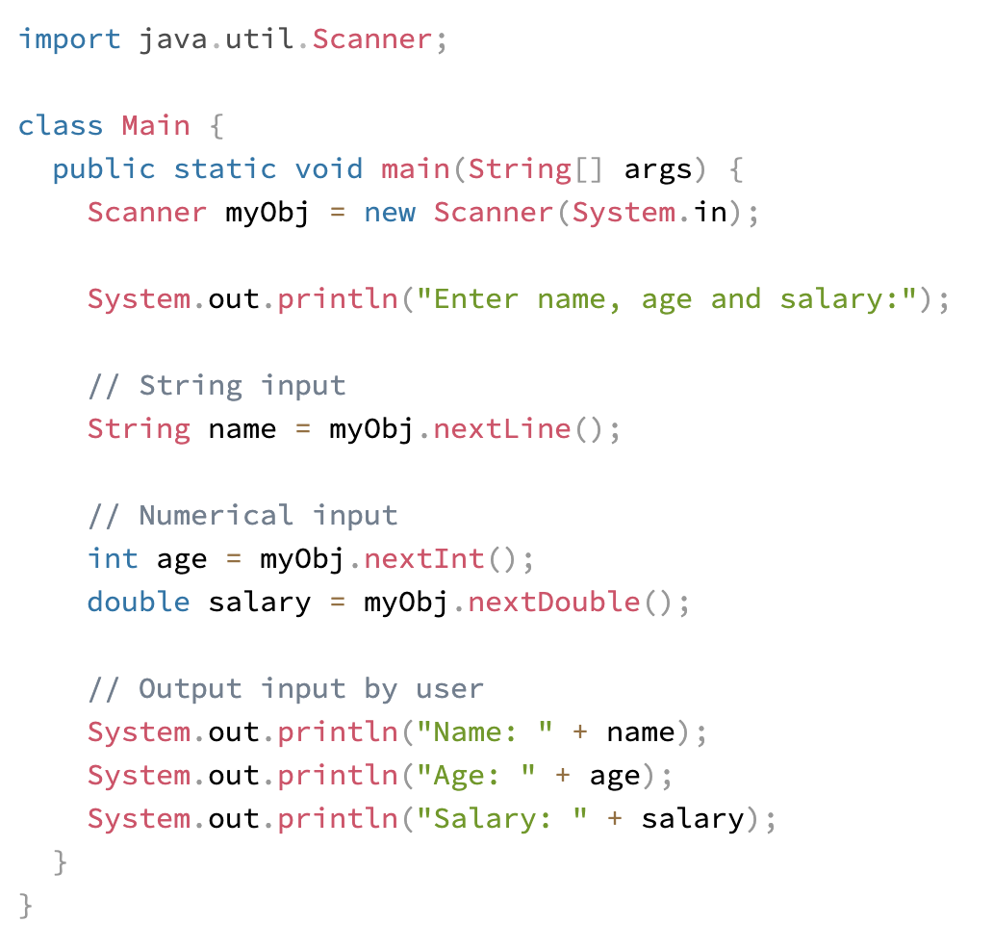

Slide 17

Let's hop in live share

Slide 18
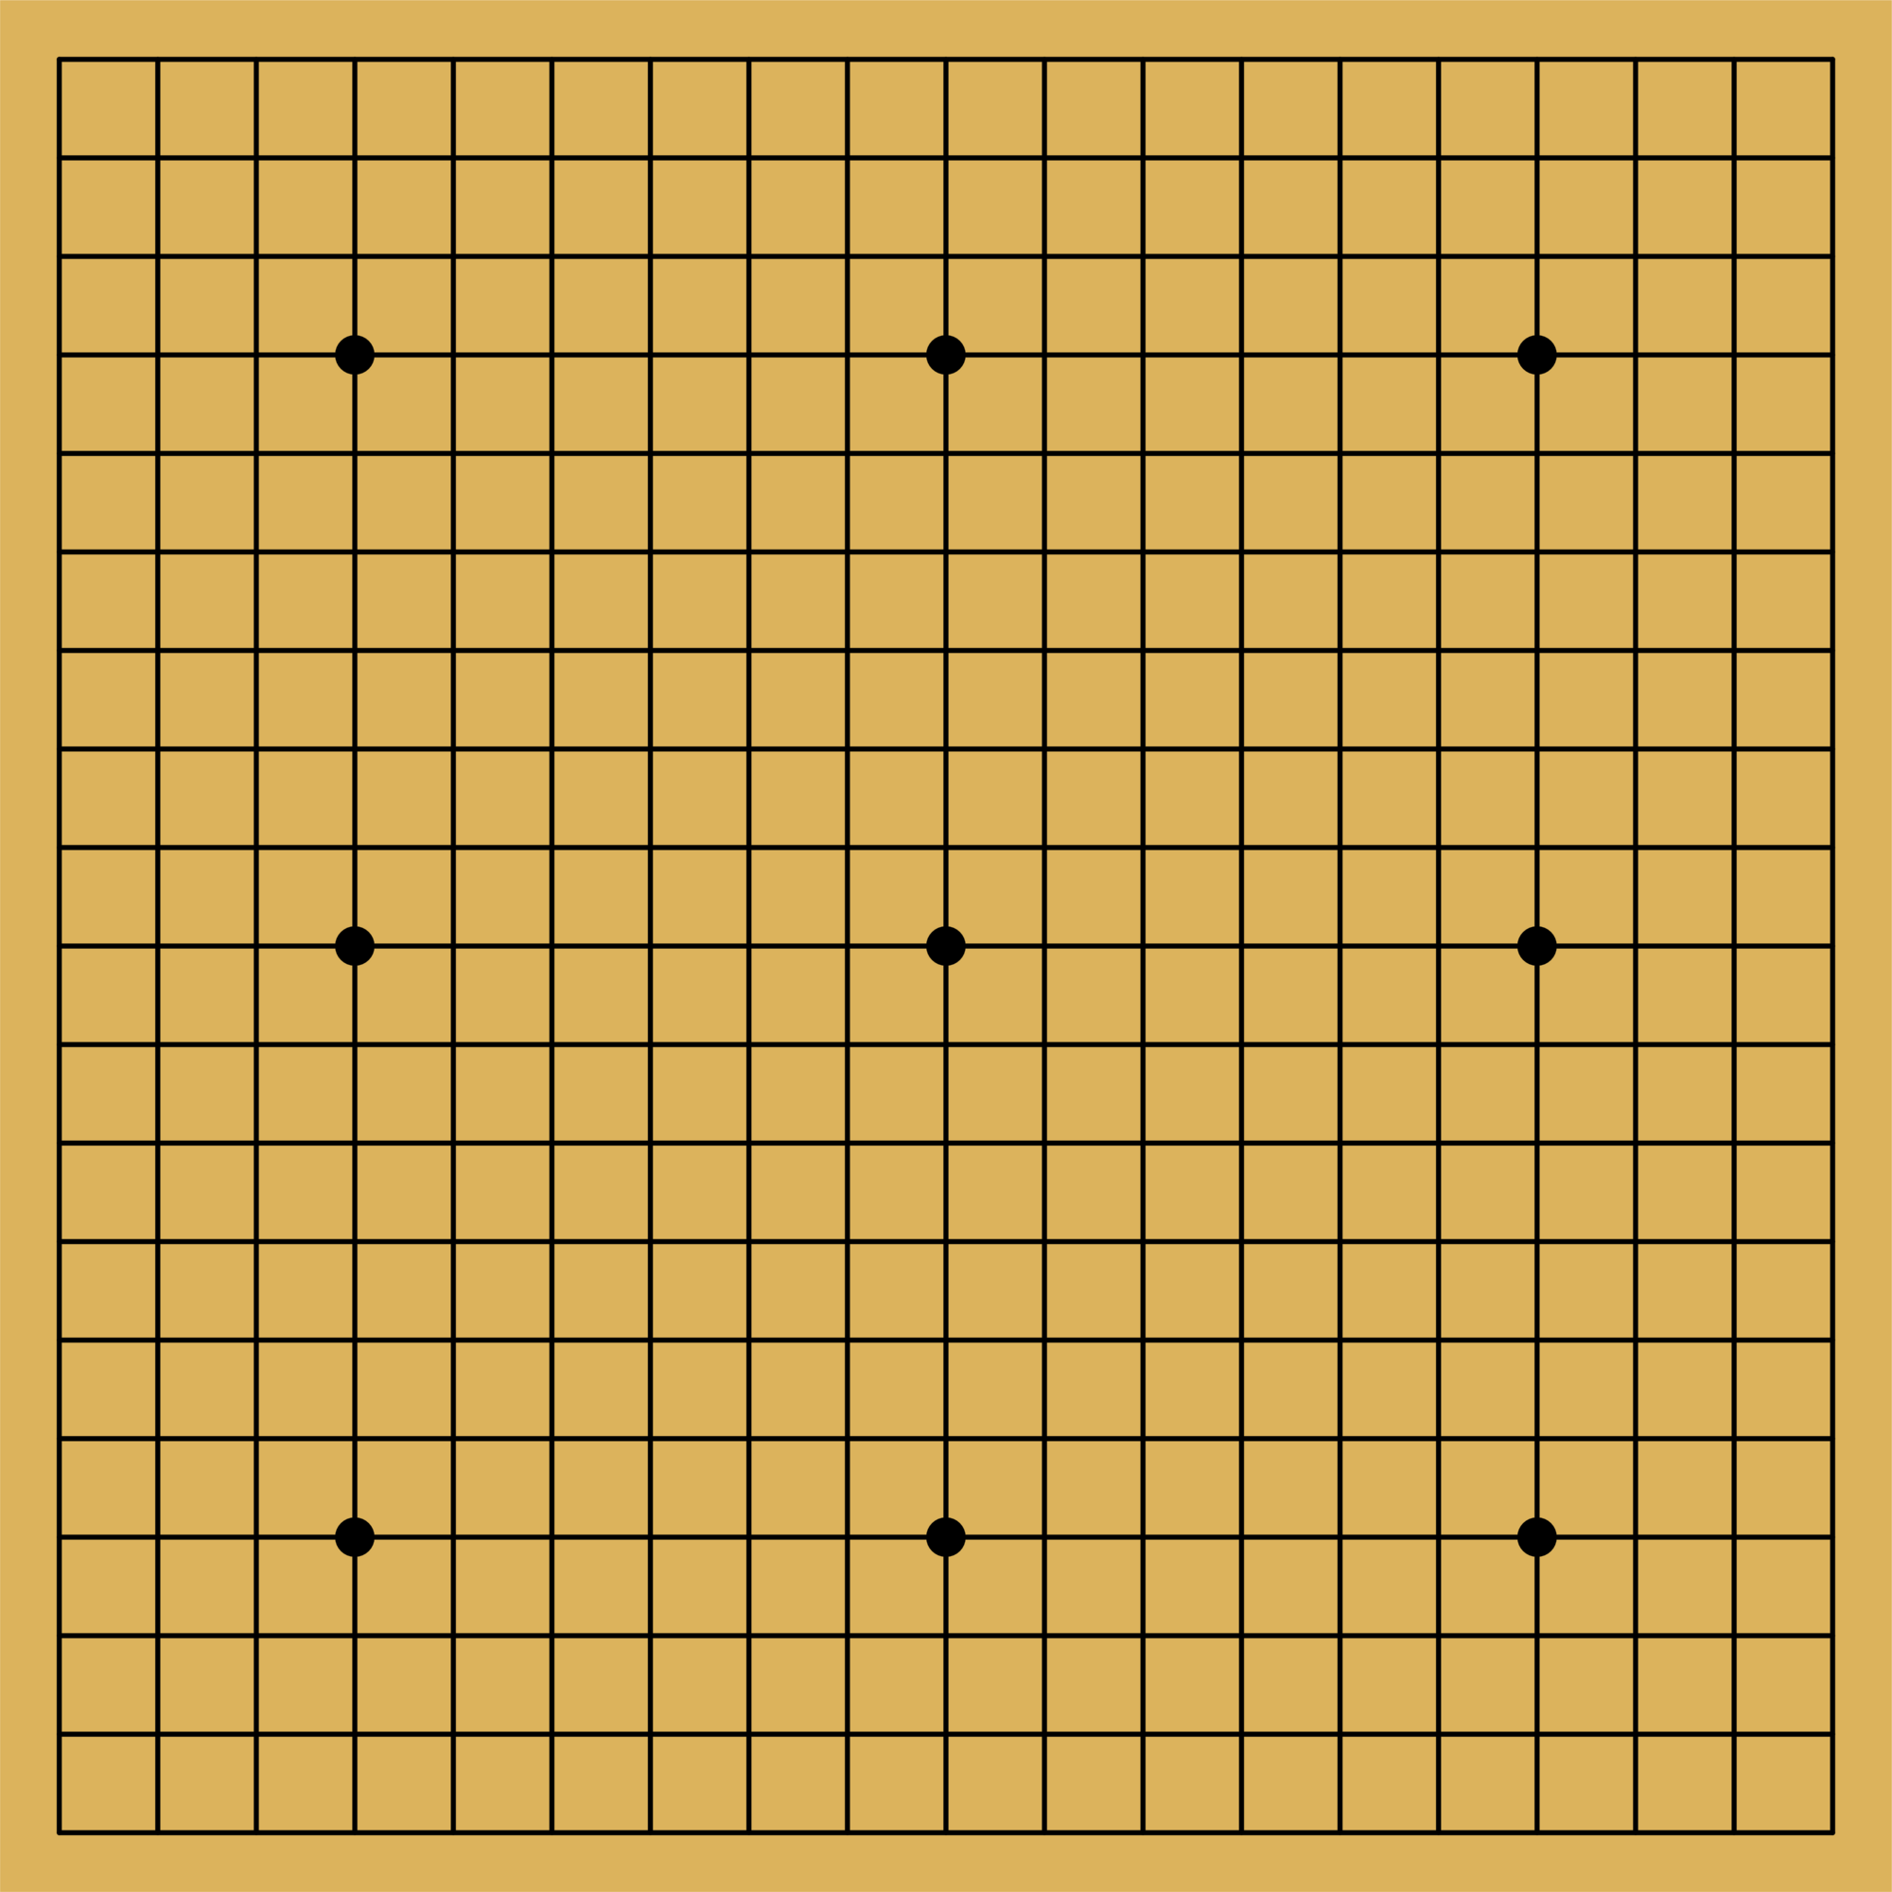
Your task
Navigate to your own project.
Create a two-dimensional array representation of a go board.
Place two go pieces, one black and one white, on the board.
Print out the board with its signature crosshatch pattern.
Next mark out addresses on your board.
Start asking the user for an x and y coordinate for placing a piece.

Slide 19
Closing
Please Read: 1.4 and 1.5 Input and Output
Office Hours In SS-411:
Tu & Th 2pm – 3pm
Mon & Wed 10am–11am
Have a great weekend and I’ll see you on Friday!

